Slide 1
CSE 109
Computer Programming
Arrays and Strings
Prepared by
Johra Muhammad Moosa
Assistant Professor
CSE, BUET
Modified by
Madhusudan Basak
Assistant Professor
CSE, BUET

Slide 2
Array
List of variables of same type
Accessed through a common name
General form
  type var_name[size];
  int myarray[20];
  int m[10], a[5];
Accessed by indexing
  Known as subscript
  Can be any valid expression
  Begin at 0
  myarray[1] : 2nd element
Array elements are stored in contiguous memory location

Slide 3
Array (Initialization)
int n[6]={48, 53, 26,71, 9, 12};
float n[]={3.1, -5, 2.5, 17.4, 29};
  Array dimension optional
48 | 53 | 26 | 71 | 9 | 12
3.1 | -5 | 2.5 | 17.4 | 29

Slide 4
Array
int a[5];
for(int i=0; i<5; i++) a[i]=i;
After the declaration
  20 bytes get reserved in memory
  Each integer 4 bytes long
 | a[0] | a[1] | a[2] | a[3] | a[4]
a | 0 | 1 | 2 | 3 | 4
 | 4002 | 4006 | 4010 | 4014 | 4018

Slide 5
Array
Can be used anywhere a variable/constant can
  int a[5];
  for(int i=0; i<5; i++)
  scanf("%d", &a[i]);

Slide 6
Array
C does not perform any bound checking on array index
Program may crash
  int a[5];
  for(int i=0; i<5; i++) a[i]=i;
  printf("%d\n", a[10]);//a[5]

Slide 7
Array
It is not possible to assign one entire array to other array
  int a1[5], a2[5];
  a1=a2; //not possible
Need to copy explicitly
  for(int i=0; i<5; i++)
  a1[i]=a2[i];

Slide 8
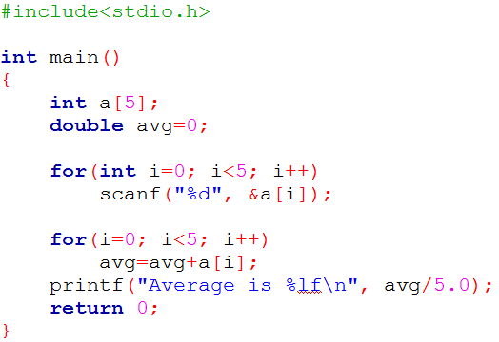
Array
Average calculation

Slide 9
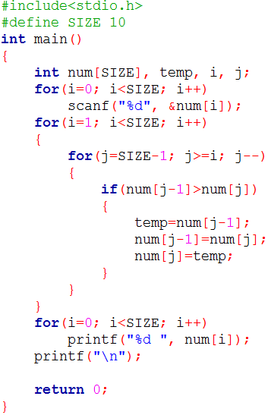

Array Bubble Sort

Slide 10
Array Bubble Sort
One traversal = move the maximum element at the end
Links to bubble sort simulation
If you understand bubble sort in the class, then you need not study the following resources.
http://www.cc.gatech.edu/~bleahy/cs1311/cs1311lecture16wdl.ppt
http://max.cs.kzoo.edu/~abrady/DSAlgs/Sorting/BubbleSort.Alyce.ppt
http://en.wikipedia.org/wiki/Bubble_sort#Step-by-step_example

Slide 11
Array Homework
Find nth maximum of an array. [Hint: sort the array in decreasing order. Return (n-1)th element of the array]
Some digits are given (in character format. Print the corresponding number. For example, 123 are given as digits, convert the digits to number 123. [Hint: Take digits until an enter (‘\n’) character is pressed. Then convert it to number.]
A number is given. Output the digits of that number.
Histogram/frequency of an array elements
Maximum subarray sum
Index sort
Standard deviation
Merge two sorted arrays into another sorted array
Given an array. Insert a number n is the ith position of the array. n and i will be given by the user.
Reverse an array
Change case of an character array
Remove all occurrences of a particular elements from an array
Sort an array from xth position to yth position. An array and the value of x and y are given.

Slide 12
Array Homework
More exercises
See the First 22 problems in the list. Some problems require recursion. You should not use function and recursion at this stage. Just try to solve the problems with using loop and array.
https://codeforwin.org/2015/07/array-programming-exercises-and.html

Slide 13
String
Most common use of one dimensional array is string
C has no built in string datatype
One dimensional character array terminated by a null ('\0')
'\0' & '0' are not same
  Value of '\0' is 0 and considered false
  Value of '0' is 48
Array size must be at least one byte larger than the string size to make room for the null
Terminating null is important
  Indicates where string ends
A string constant is automatically null-terminated by the compiler
'C' | 'S' | 'E' | '1' | '0' | '9' | '\0'
String Size: 6, Array Size: 7

Slide 14
String
char dept[]={'E', 'E', 'E', '\0'};
 | dept[0] | dept[1] | dept[2] | dept[3]
dept | 'E' | 'E' | 'E' | '\0'
 | 4001 | 4002 | 4003 | 4004

Slide 15
String
char dept[]=''EEE'';
  Shortcut for initializing string
  '\0' is not necessary in this declaration
 | dept[0] | dept[1] | dept[2] | dept[3]
dept | 'E' | 'E' | 'E' | '\0'
 | 4001 | 4002 | 4003 | 4004

Slide 16
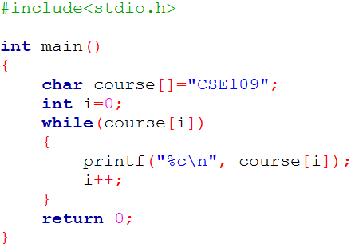
String
Output:
C
S
E
1
0
9

Slide 17
String Read using scanf()
%s is used in scanf
Reads characters untill ENTER pressed
ENTER key is not stored, replaced with null character
No bound checking
Can not read multi word string
  "Department Name: EEE"
scanf("%s", s);
  Just the array name is used
  No & (ampersand) is used

Slide 18
String Read using gets()
gets()
  Library function
  Defined in stdio.h
  Call it using the name of the character array without using any index or ampersand (&)
    gets(s)
  Reads characters untill ENTER pressed
  ENTER key is not stored, replaced with null character
  No bound checking
  Can receive multiword string

Slide 19
String Write
Using %s in printf
  printf("%s", s);
Using puts()
  puts("hello")
  puts(s)

Slide 20
String
Each character occupies one byte of memory
Number of possible values in a string of length 3 is 255³
 | dept[0] | dept[1] | dept[2] | dept[3]
dept | 'E' | 'E' | 'E' | '\0'
 | 4001 | 4002 | 4003 | 4004

Slide 21
String Library Functions
strlen : Finds the length of the string
strcat : Appends one string at the end of the other
strcpy( to, from): Copies one string into another
strncpy : Copies first n characters of one string into another
strcmp (s1, s2): Compares two strings
  Returns 0 if same
  -ve if s1 less than s2
  +ve if s1 greater than s2
strchr : Finds first occurrence of a given character in a string

Slide 22
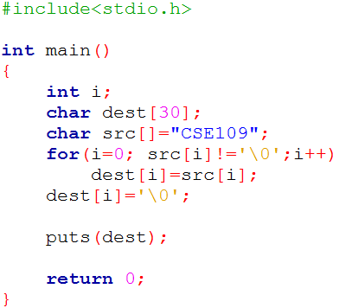
String Library Functions
strcpy

Slide 23
Homework
Anagram check
Palindrome check
To upper each word
Count number of words
Remove multiline comments from a code

